Slide 1
SSW-810: Software Engineering Tools and Techniques
Building Web Sites with Python and Flask
Prof. Jim Rowland
Software Engineering
School of Systems and Enterprises

Slide 2
Acknowledgements
This lecture includes material from:
http://www.tutorialspoint.com/dbms/
https://www.tutorialspoint.com/html/
https://gertjanvanhethofblog.wordpress.com/2016/02/10/exploring-flask-on-raspberry-pi/
http://flask.pocoo.org/

Slide 3

Today’s topics
Tying it all together
HTML
Integrating web pages and Python
Flask
Building a simple web site to display student information

Slide 4
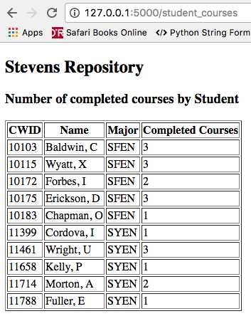
What problem are we trying to solve?
Goal: build a simple web site
Display the information in our Student Repository
Display data from our SQLite database
Limitations:
Not a lesson in HTML
Not a lesson in good web design

Slide 5
Oversimplified Web Overview
Web Browser
http://testpad.asna.com/tutorials/Images/DataServerWebServer.gif

Slide 6
Static and Dynamic HTML
Many HTML pages have static content
hello.html
Kitten videos
Others pages require generating HTML dynamically
Display the latest messages from a blog
Display the latest Tweets
Display information from a database
The Web Server may generate the HTML dynamically using information retrieved from a database or other source

Slide 7
Oversimplified Web Overview
1. GET hello.html
4. Render the HTML
3. Return the HTML
2. Retrieve hello.html
<!DOCTYPE html>
<html>
<body>
<h1>Hello World!</h1>
</body>
</html>
Not used in this example…
http://testpad.asna.com/tutorials/Images/DataServerWebServer.gif

Slide 8
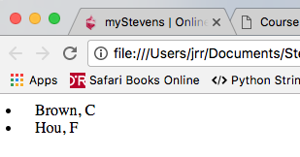
Dynamic Web Pages
1. GET All Students
5. Render HTML
4. Return generated HTML
<!DOCTYPE html>
<html>
<TABLE>
<LI>Brown, C</LI>
<LI>Hou, F</LI>
</body>
</html>
2. Get student data
3. Create HTML dynamically
http://testpad.asna.com/tutorials/Images/DataServerWebServer.gif

Slide 9
Python, Flask, Jinja2
Flask serves the role of the Web Server
https://gertjanvanhethofblog.wordpress.com/2016/02/10/exploring-flask-on-raspberry-pi/

Slide 10
Hello World with Flask
Install Flask and its supporting packages
Create a web server program with Python and Flask
Return “Hello world” to the browser
Run our web server program
Point to our web server with a browser
Say “Hello”!

Slide 11
Installing the packages
Mac/Unix
$ pip install flask
C:\> pip install flask
Windows
Add the Flask package to your Python environment

Slide 12
Background: Python decorators
Python decorators provide additional information about a function or class definition
Decorators augment the definition of a function or class without changing the definition of the function or class
@staticmethod
def foo(): “”” This is a static method “””
@app.route(‘/hello’)
def hello_page():
return “Hello world!”
Specify that foo is a static method
Call hello_page() function when the user requests the ‘hello’ page. Return the result to the web browser
Return any valid HTML to be rendered by the browser

Slide 13
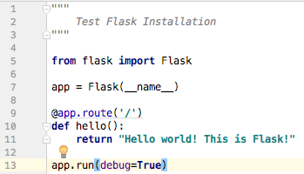
Step 1: Flask Hello World
Create hello.py which will be our web server
Call ‘hello()’ when the browser requests the default page
The return value will be rendered by the browser
Automatically restart if anything changes

Slide 14
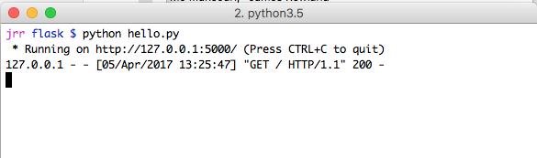
Step 2: Running the Flask Web Server
Start your hello.py program from a shell/command window, not from an IDE
Someone accessed your default page with a GET request
Hit ^C to stop the process to shut down the server after testing or to make changes to the program
Don’t run Flask programs from PyCharm, VS Code, or other IDEs - only from the command line

Slide 15
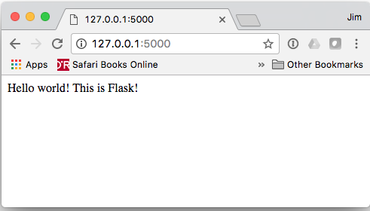
Step 3: Accessing the Flask Web Server
1. Start your hello.py program from a shell/command window, not from Spyder
2. Open your browser and enter 127.0.0.1:5000 as the URL
4. Hit ^C to stop the process
3. Here’s the string returned by our hello() function
Recreate this scenario on your machine to verify that Flask is installed and working properly.

Slide 16
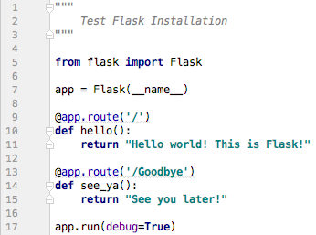
Add Goodbye page to our site
Our Flask web server can support many pages
Specify the URL and write a function that returns the HTML string to be rendered by the browser

Slide 17
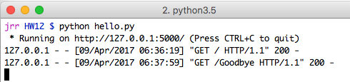
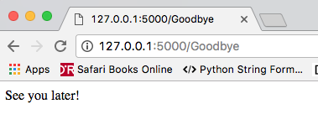
Add Goodbye page to our site
Add new code to hello.py to support the ’Goodbye’ page
app.run(debug=True) detects that hello.py changed and reloads automatically
Test the new feature!

Slide 18
Making pages more interesting
We want to support more interesting pages
e.g. display variables from Python in the HTML page
(the first step in dynamic web content)
Flask works with a number of components including Jinja2
Jinja2 provides a bridge between Python and the generated HTML
https://gertjanvanhethofblog.wordpress.com/2016/02/10/exploring-flask-on-raspberry-pi/

Slide 19
Flask application directory structure
Flask/Jinja2 requires a specific directory structure
MyAppDir/
templates/
base.html
template1.html
static/
scripts
my_program.py
template2.html
styles
my_css.css
my_script.js
Javascript programs
CSS files
Define the standard page layout for all pages
Templates define individual pages and combine HTML and Python code

Slide 20
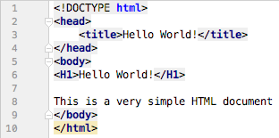
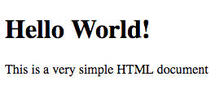
HTML Intro
HTML5 – HyperText Markup Language
A Language to specify the content and the appearance of pages
<tag> provides layout hints </tag>

Slide 21
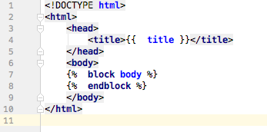
Jinja2 base.html
templates/base.html defines a base template that will inherited by other pages in your project
This is especially helpful when using CSS or creating multiple pages with a consistent look and feel
{{ title }} will be replaced by a value provided by your program in the HTML
Everything between
{% block body %} and
{% endblock %}
will be replaced by a template page that inherits from this page

Slide 22
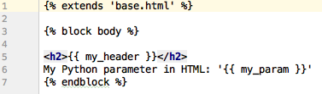
Jinja2 templates
templates/my_program.html inherits from the base template in base.html and adds HTML to your specific page
Define the block body that will plug into base.html
{{ my_header}} and {{ my_param }} will be replaced by values from your Python program

Slide 23
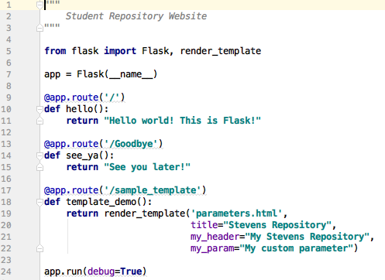
Jinja2 templates
Apply the template from your program
Import render_template from flask
render_template(template, params) combines the specified template.html, base.html, and parameter values from your Python program to create an HTML document
Add a new web page

Slide 24
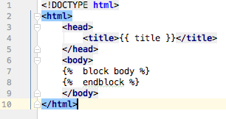
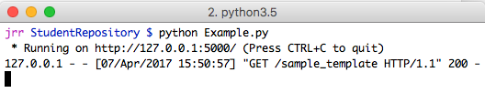
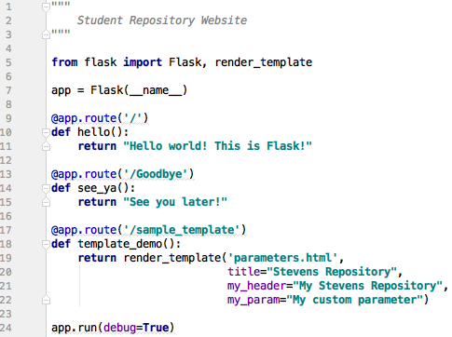
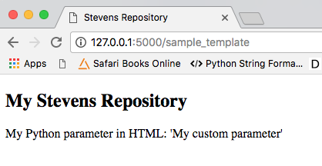
Jinja2 templates
1. templates/base.html
2. templates/parameters.html
4. Terminal running Example.py
3. Example.py
5. Brower rendering sample_template

Slide 25
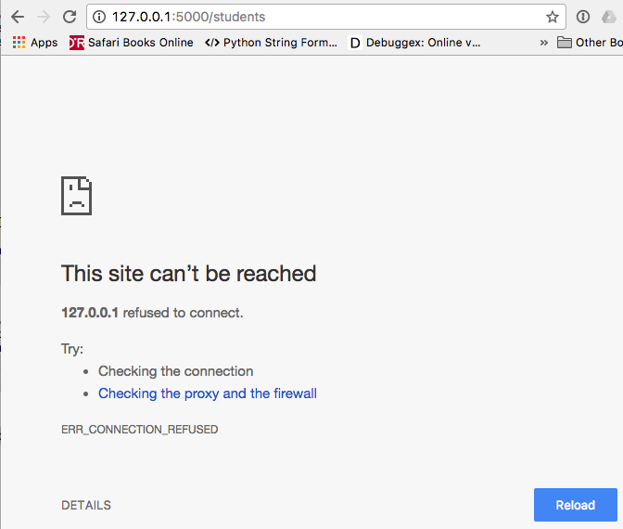
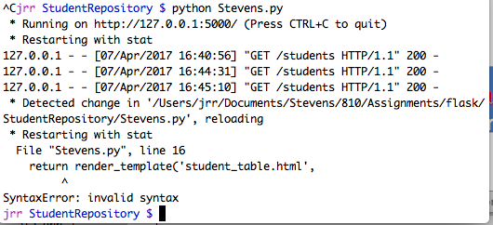
When things go wrong…
Browser window
If the browser can’t connect, check the shell/command window running your Python program
Shell/Command window
Fix the syntax error in the Python program and try again

Slide 26
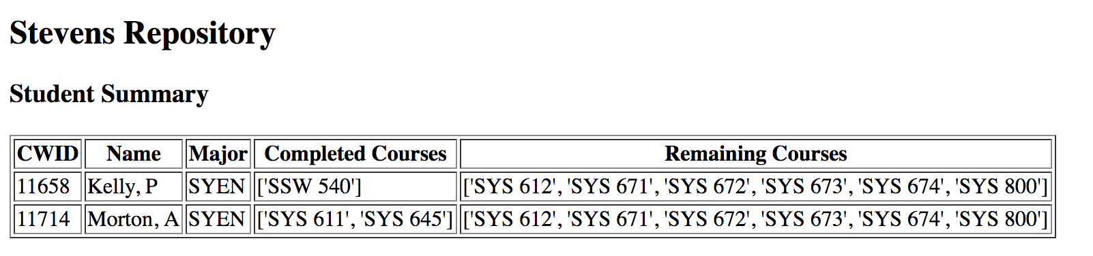
Moving Student Data to the Web
Goal: present our Student Summary from HW 9 & 10 as a web page

Slide 27
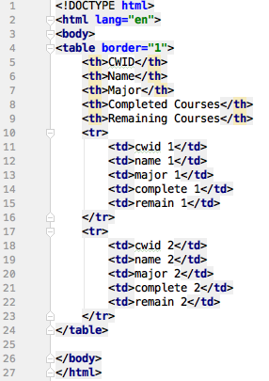
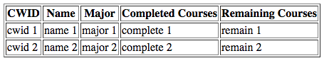
Intro to HTML Tables
HTML for four column, two row table
TH: Table Header (column)
Table rendered in the browser
TR: Table Row
TD: Table Data (row/col)
Goal: update our template to generate HTML for an arbitrary list of student data

Slide 28
Displaying tables with Flask & Jinja2
We’ve seen HTML for tables
We know how to pass parameters from Python to Jinja2
How to display Python containers in HTML?
Store parameters in a dict and pass to Jinja2 as parameters
Jinja2 supports iterating through sequences
<table>
{% for item in sequence %}
<tr>
<td> {{ item }} <\td>
<\tr>
{% endfor %}
</table>
Jinja2 iterates through the items in a sequence
Use the value from the sequence
End of the Jinja2 for loop

Slide 29
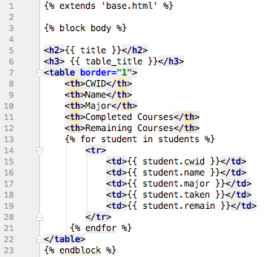
Displaying tables with Flask & Jinja2
Update templates/students_table.html
Surround the table with borders
<th> table/row headers </th>
<tr> Table Row </tr>
We don’t know, and don’t care, how many items in the list
Add a row to the table with 5 columns for each dict in the list passed in from Python

Slide 30
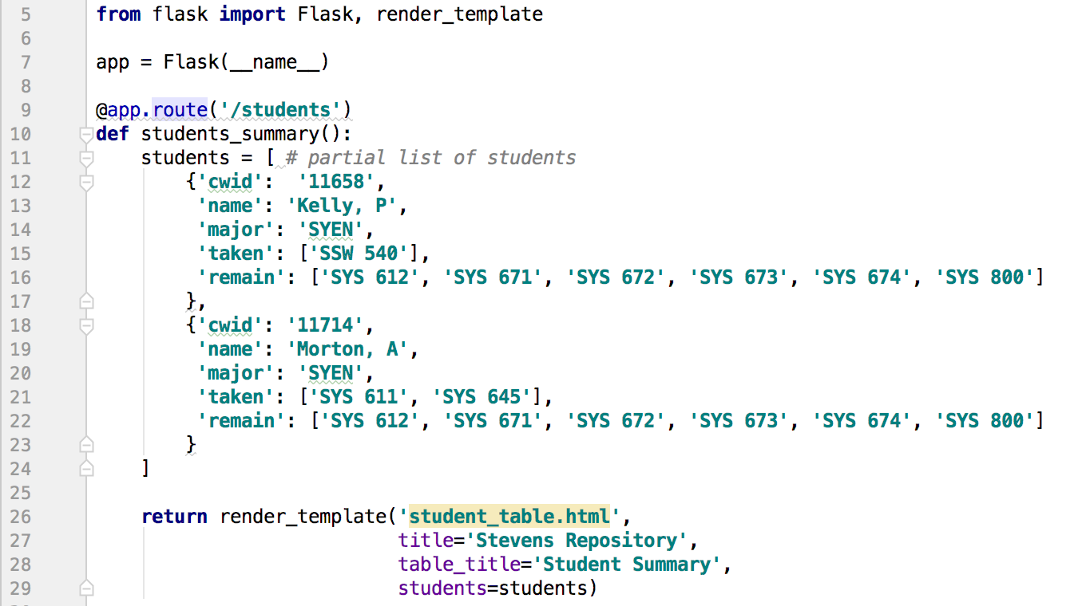
Displaying tables with Flask & Jinja2
Update Stevens.py
Jinja2 supports JSON format for complex data
Pass in a list of students in JSON format
Python represents JSON as a dictionary with keys and values
Access each key/value separately in template/*.html
Pass the list of dicts to the HTML template

Slide 31
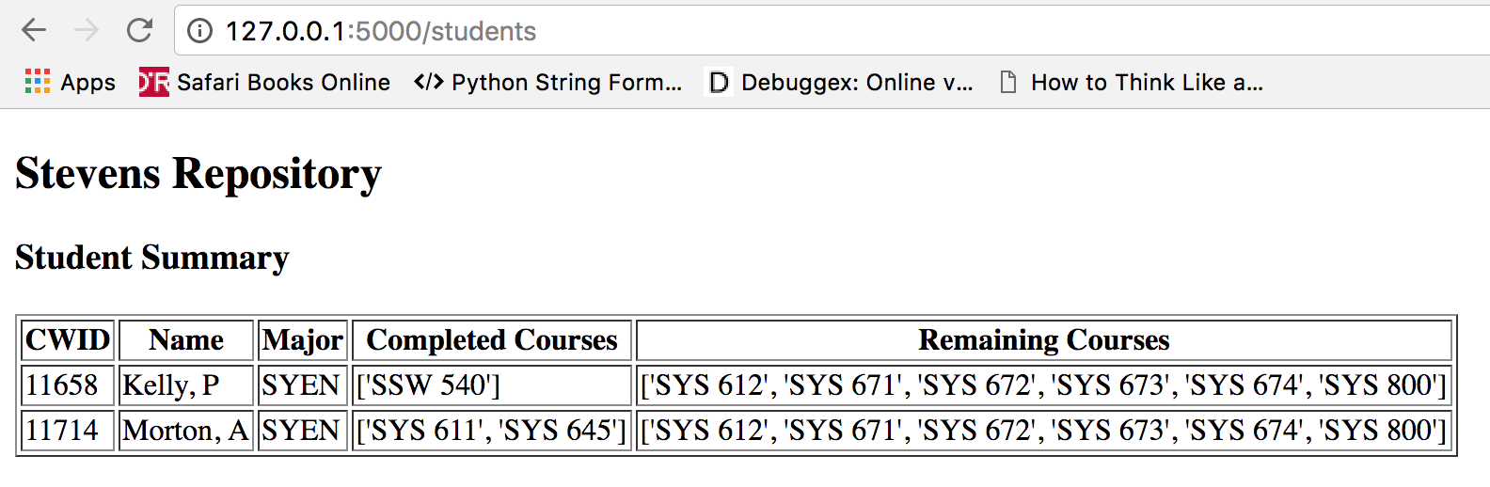

Displaying tables with Flask & Jinja2
Templates/student_table.html
Browser Window
Stevens.py

Slide 32
Running database queries from Python
import sqlite3
Specify the Sqlite database file name
Specify the query
Open a connection to the database
Execute a query
Fetch the results
Use the results in your Python program

Slide 33
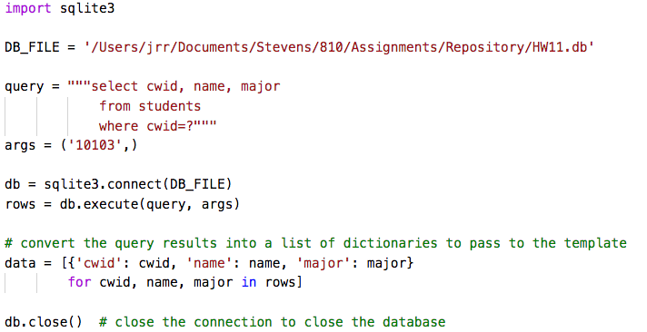
Retrieving data from a database
Specify the database file
Specify the query
Specify the args in the query
Connect to the database
Execute the query
Store the results in a list of dicts to pass to Jinja2 template
Close the connection

Slide 34
Display # completed courses by student
Steps:
Write a query to pull the data
Create a template for the new web page
Update Stevens.py with a new function to return the HTML for the web page on our growing web site
Connect to the database
Run the query
Convert the results to a list of dicts
Render the new template and the database query results to Jinja2
Earn fame and fortune

Slide 35
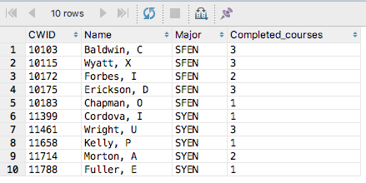
Query to compute completed courses
DataGrip
Query
Query Results

Slide 36
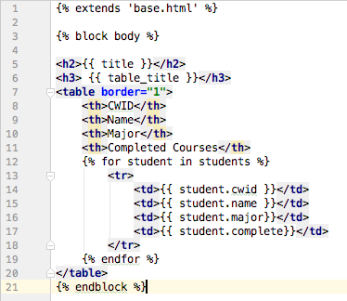
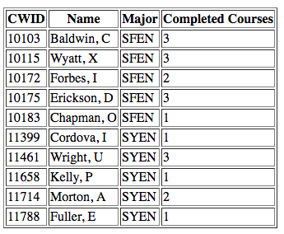
Generate a new template
templates/student_courses.html
Desired output in the browser
Values to pass into the template from Python.
Use var.key to access the value of key in the dict

Slide 37
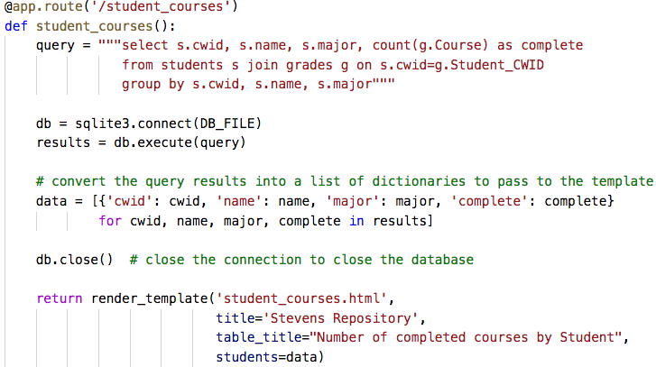
Update Stevens.py
Stevens.py
Specify the query
Execute the query
Convert the query results into a list of dictionaries
Render the template

Slide 38
Success! Display the results
The new template
Titles are passed to the template
Execute the query
Database query results presented on a web page

Slide 39
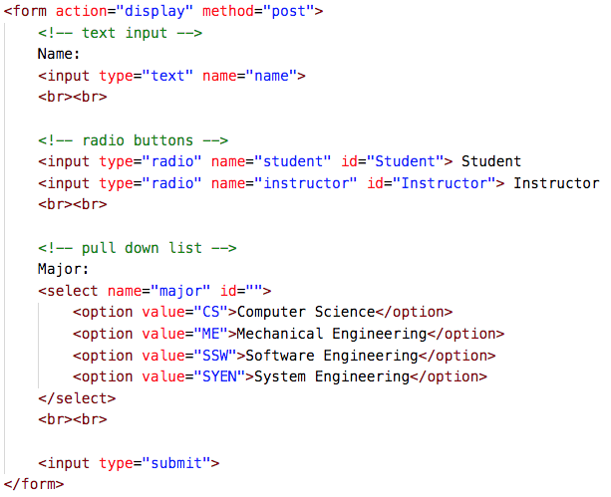
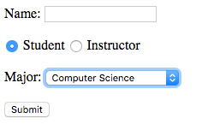
Intro to HTML Forms
Rendered Form
HTML

Slide 40
Populating HTML Forms with Flask
Use Flask and database queries to populate forms
Replace hard-coded values with computed values

Slide 41
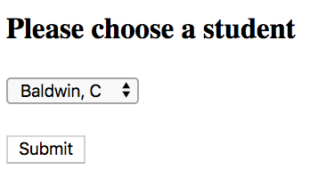
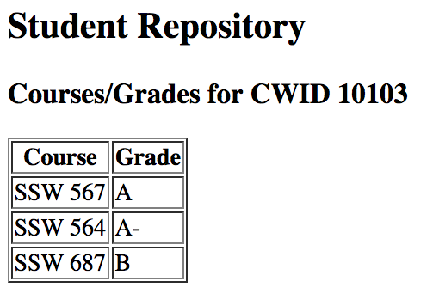
To Do:
Render a page with all student names
Ask the user to choose student
Display all courses and grades for that student
All student names from database
Results for specified student

Slide 42
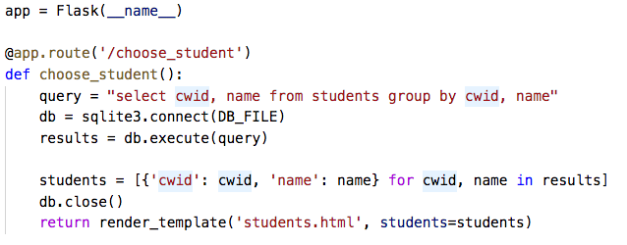
Populating HTML Forms with Flask
students.py – a Flask app runs a query to pull the student names and renders students.html to present a form
Replace hard-coded values with computed values
Retrieve all student names from database
Render a form with the names and allow user to choose student

Slide 43
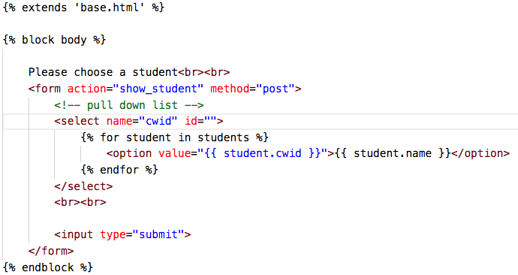
students.html
Display a pull down menu with all students’ names
Page to render on submit
Add a drop down menu option for each student’s name
Return the CWID
Display the student’s name

Slide 44
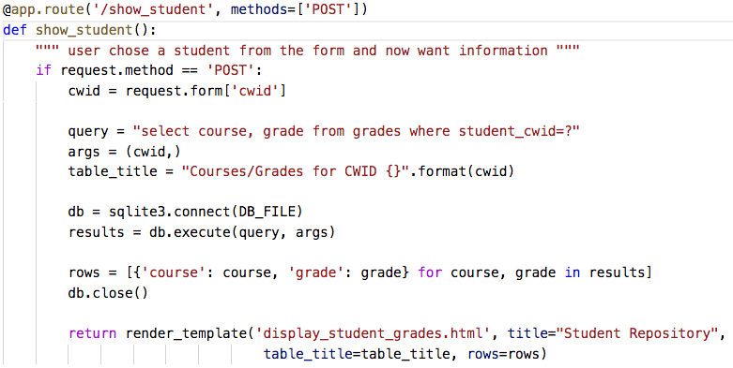
Retrieve the student courses/grades
Page rendered as result of post request from form
Retrieve the cwid selected on the form
Replace hard-coded values with computed values
Retrieve the courses and grades from database
Render page with the results

Slide 45
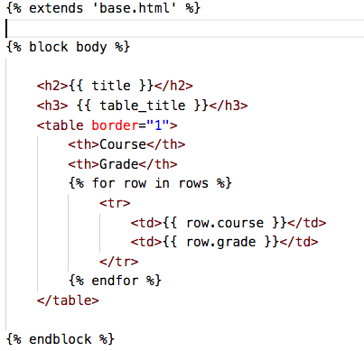
display_student_grades.html
Page rendered as result of post request from form
Display a table with the courses and grades passed in from Python

Slide 46
Success!
Rendered a page with all student names
Asked the user to choose student
Displayed all courses and grades for that student
All student names from database
Results for specified student

Slide 47
Learning more about Flask Extensions
Flask supports many extensions to add functionality
Flask-Ask – create Amazon Echo apps easily
Flask-Login – user session management, logging in/out
Flask-Mail – send mail from Flask
Flask-MongoAlchemy – MongoDB support
Flask-Oauth – common login support
Flask-Principal – user authentication management
Flask-SQLAlchemy – support SQLAlchemy
Flask-Uploads – upload and serve files
Flask-User – User account management
See : http://flask.pocoo.org/extensions/

Slide 48
Learning more
Flask resources
http://flask.pocoo.org/
http://flask.pocoo.org/docs/0.12/tutorial/introduction/
https://blog.miguelgrinberg.com/post/the-flask-mega-tutorial-part-i-hello-world
Python and SQLite
http://sebastianraschka.com/Articles/2014_sqlite_in_python_tutorial.html
Python and Databases
http://www.sqlalchemy.org/

Slide 49

Questions?

